Slide 1


London Underground
Preliminary Results from Hampstead Measurement Campaign
Franklin Wilkins Building
29th January 2016
www.environment-health.ac.uk

Slide 2
Agenda
Background
Analysis results so far
Mass
Aethalometer
Laboratory Measurements
EC/OC
Elemental analysis (ICP-MS)
Personal Exposure
Planned outputs

Slide 3
Background
Increasing number of small personal exposure monitors available to public and in use for screening by LU
Monitors calibrated for ambient environment which has substantially different PM size, density and chemical composition
Lead to misinterpretation of data
Previous measurements
IOM report (2003)
130-480 µgm-3
90% Fe

Slide 4
Aims and Outputs
Develop scaling factor for personal exposure PM measurements (TSI Sidepak)
Develop scaling factor for LU’s TSI Dusttrak
Improve understanding of response of micro Aethalometer on LU
Higher time resolution reference measurements for PM mass
High time resolution measurements of elemental composition (C, Fe)
Higher quality measurements of black carbon

Slide 5
Size fraction and time resolution
Size fraction
Needed to measure PM_{2.5} for comparison to personal exposure monitors
Routine black carbon measurements made in PM_{2.5}
Advantageous to measure a coarser size fraction to provide
Additional scaling factor for Dusttrak
Information on size distribution of PM
Only had TSP inlet available for aethalometer
Measurements undertaken in PM_{2.5} and TSP
Time resolution for filter analysis
Concentrations expected to be low overnight and high during the day
Needed to be high enough to capture range in concentration
Sample had to be long enough to be above limit of detection
4 hour samples chosen as a compromise

Slide 6
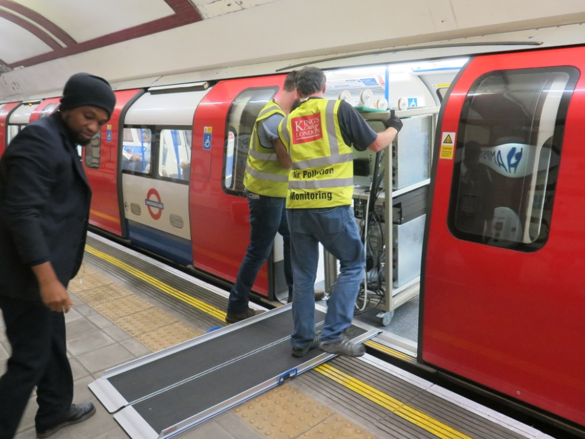
Project Outline – Plan A
Mass measurements
Filters using Partisol 2025
Personal Monitors
TSI Dusttrak
TSI Sidepak
Micro-Aethalometer
Black Carbon
Magee 7 wave length Aethalometer
Elemental and organic carbon
Filters using Partisol 2025
Elemental composition
XACT 625 X-ray Fluorescence

Slide 7
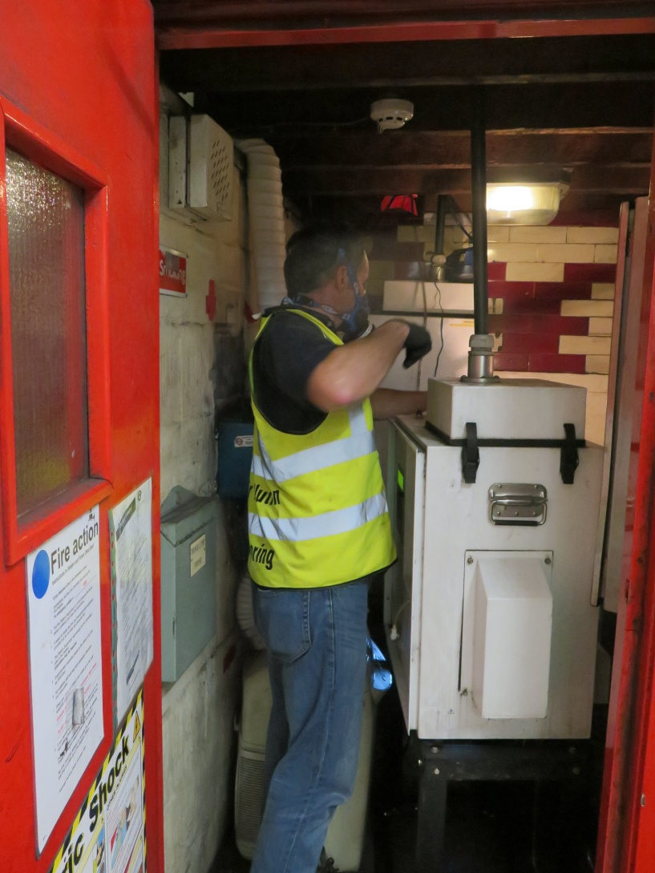
Project Outline – Plan B
Mass measurements
Filters using Partisol 2025
Personal Monitors
TSI Dusttrak
TSI Sidepak
Micro-Aethalometer
Black Carbon
Magee 7 wave length Aethalometer
Elemental and organic carbon
Filters using Partisol 2025
Elemental composition
Filters using Partisol 2025

Slide 8
Mass measurements

Slide 9
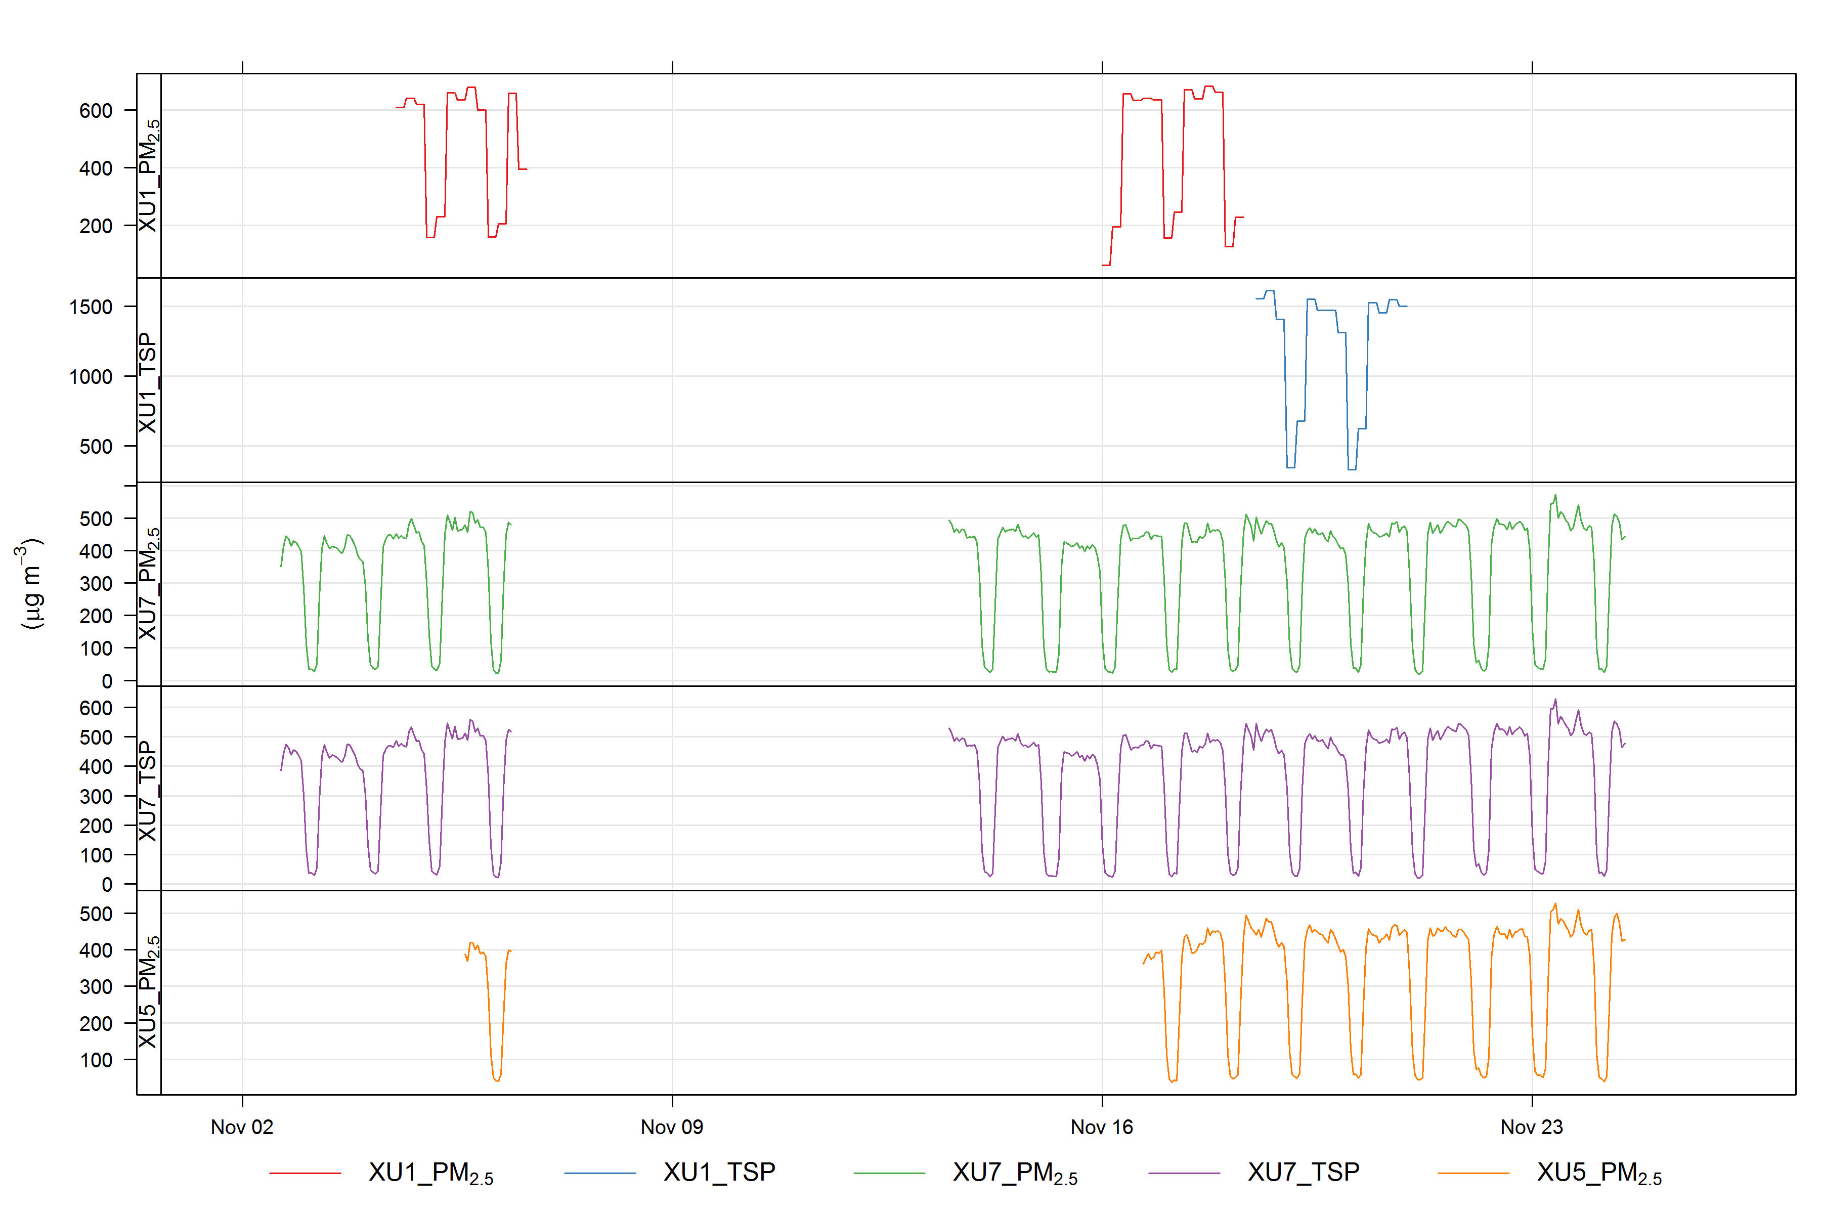

Slide 10
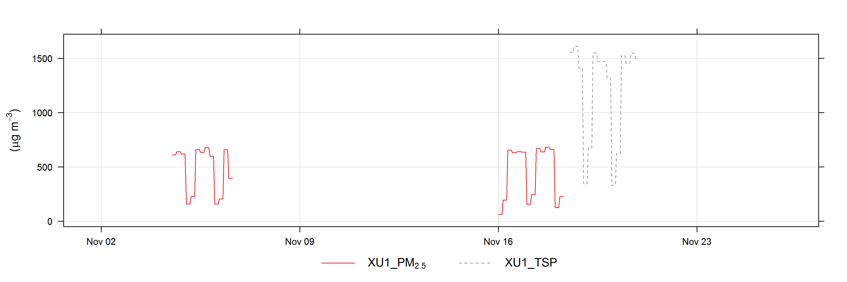
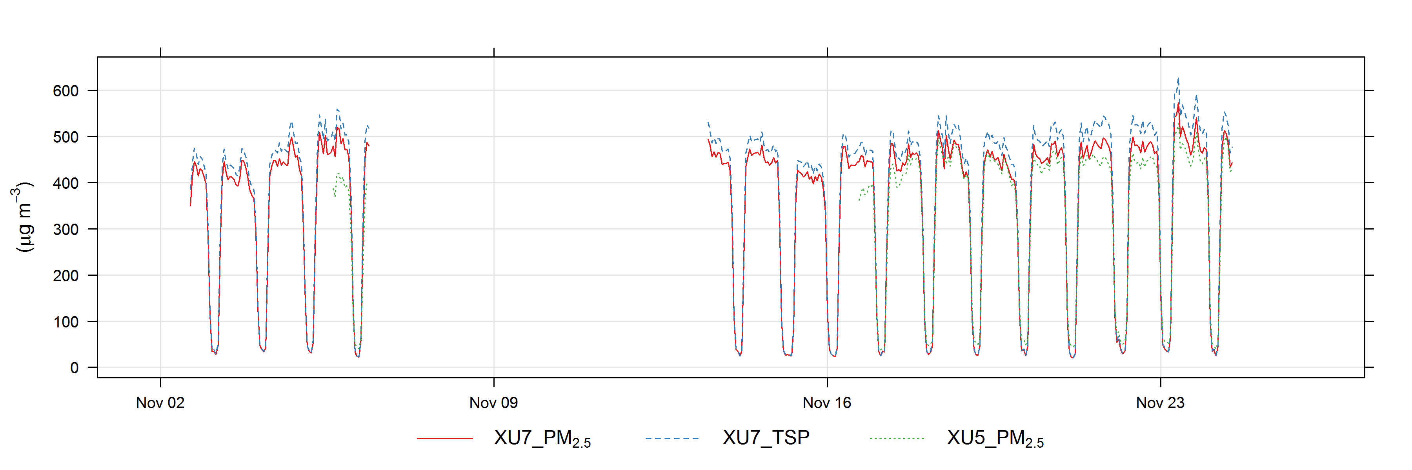

Slide 11
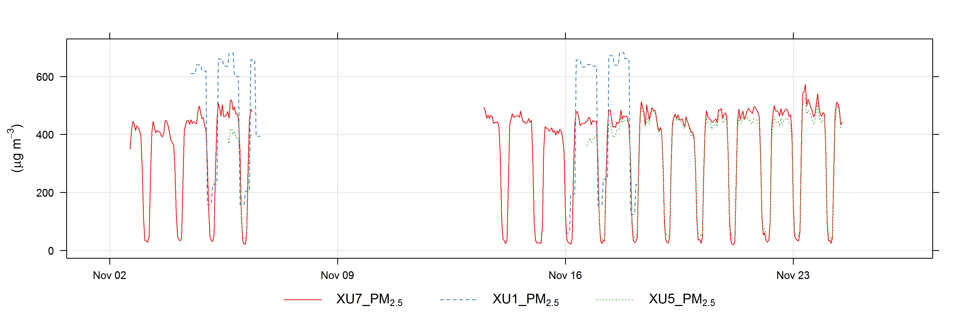
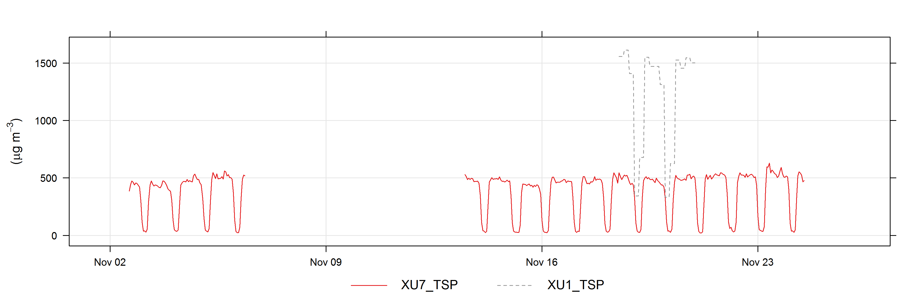

Slide 12
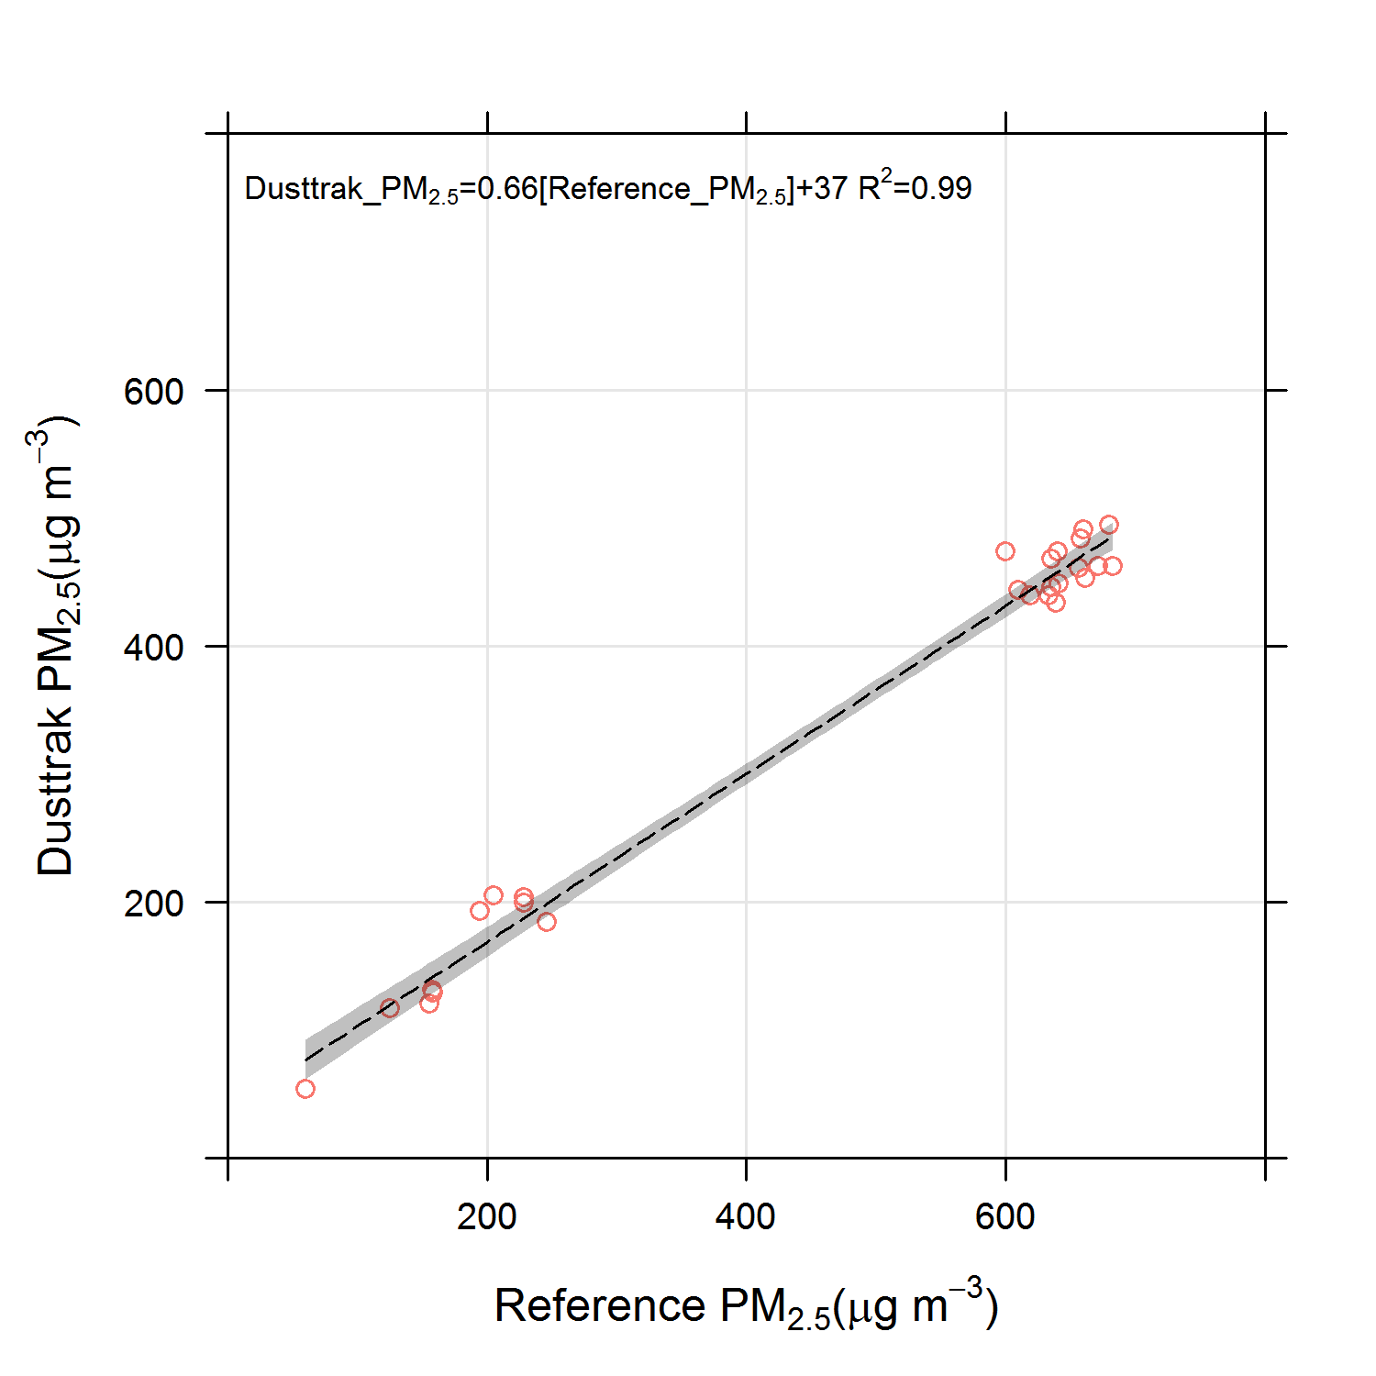
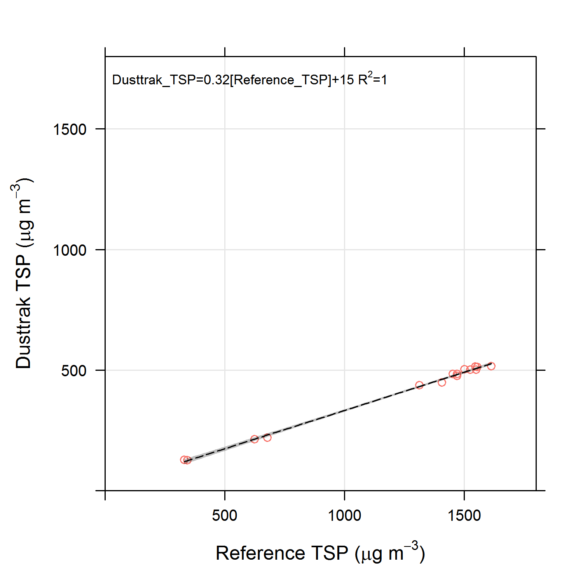
Regression Analysis

Slide 13
Aethalometer (7 wavelength)

Slide 14
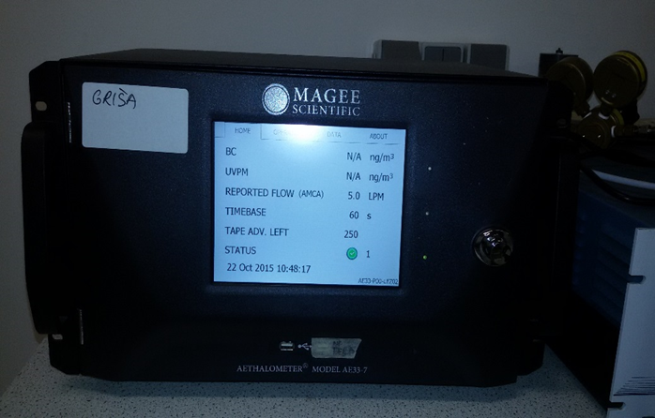
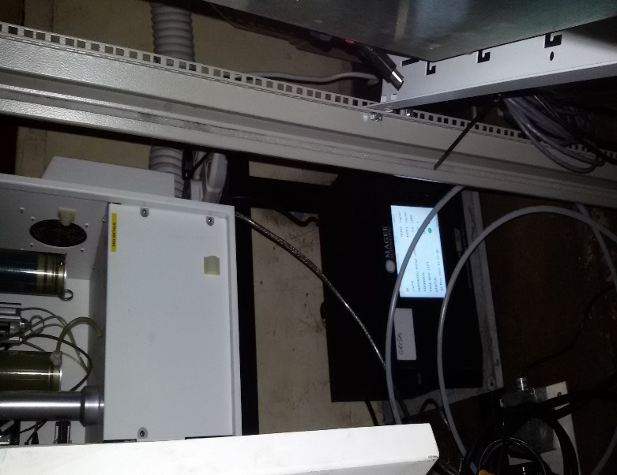
Seven wavelengths aethalometer

Slide 16
Laboratory measurements

Slide 17
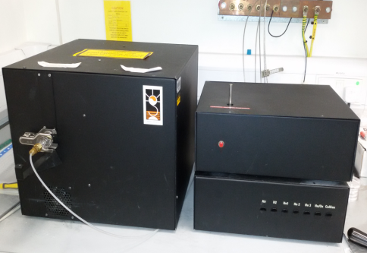
Sunset ECOC instrument

Slide 18
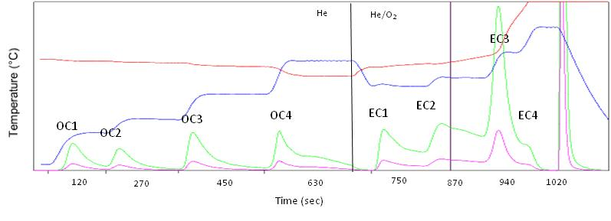
Thermogram
FID Signal

Slide 19
Elemental analysis (ICP-MS)
What additional elements do we measure?

Slide 20
PERSONAL EXPOSURE

Slide 21
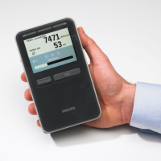
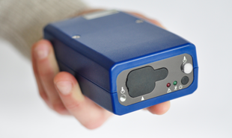
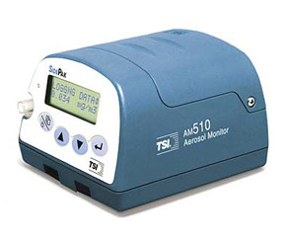
Microaeth (Black), Particle Number Counter, Sidepak (Pm2.5

Slide 22
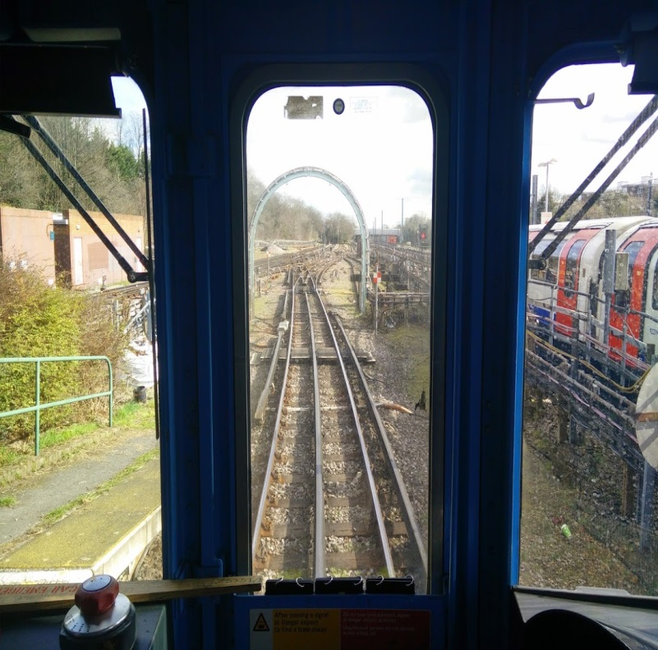
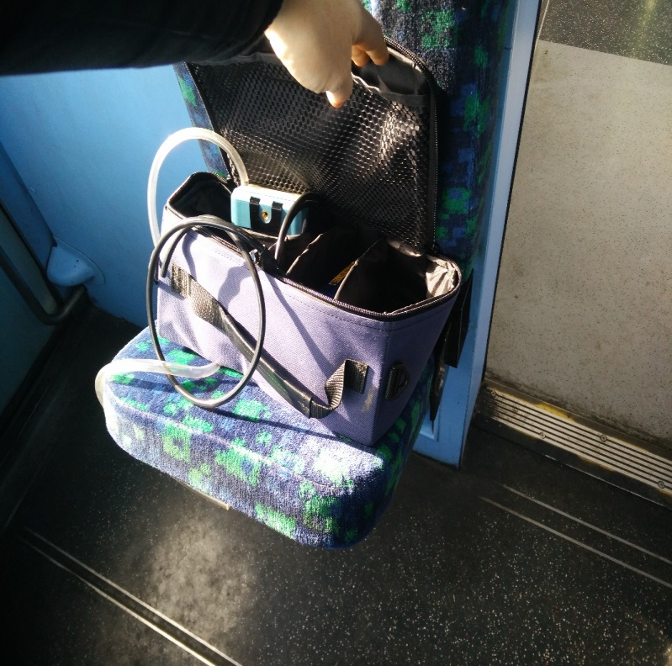
Monitoring

Slide 23
Line | Start | End | Duration
Victoria | 2014-12-08 09:03 | 2014-12-08 10:40 | 97 minutes
Circle | 2014-12-10 10:47 | 2014-12-10 13:27 | 160 minutes
Northern | 2014-12-16 08:07 | 2014-12-16 12:13 | 246 minutes
Bakerloo | 2015-02-04 08:07 | 2015-02-04 10:03 | 116 minutes
Jubilee | 2015-02-17 09:40 | 2015-02-17 13:53 | 253 minutes
District | 2015-03-03 10:07 | 2015-03-03 13:28 | 201 minutes
Piccadilly | 2015-03-17 09:25 | 2015-03-17 12:50 | 205 minutes
Docklands Light Railway | 2015-04-01 10:17 | 2015-04-01 14:35 | 258 minutes
Metropolitan | 2015-04-09 08:15 | 2015-04-09 12:30 | 255 minutes
Central | 2015-04-22 09:56 | 2015-04-22 13:36 | 222 minutes
 |  | Total | 34 hours

Slide 27
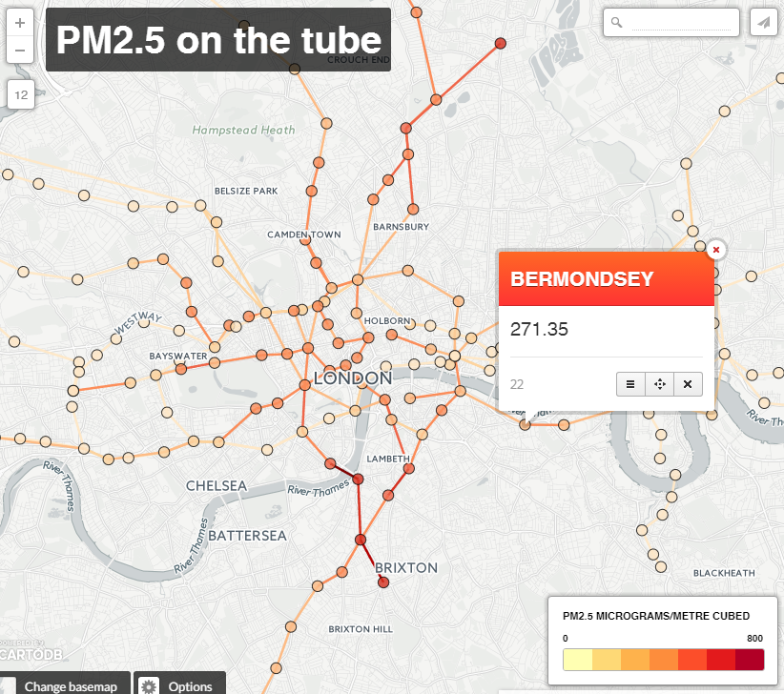
Spatial variation
Londonair.org.uk/Research/tube_pm25/

